Slide 1
INTRODUCTION TO METABOLISM
Metabolism, Energy,
Life, and Enzymes

Slide 2
Two-Minute Quiz
How can you speed up a chemical reaction?
What is a reactant? Product?
What is a catalyst?
What are two properties of catalysts?
What are the monomers/building blocks of proteins?

Slide 3
6. How many protein monomers are there?
7. What are the 4 levels of protein structure?
8. What is the primary structure of a protein?
9. How are amino acids linked together to form the primary structure of a protein?
10. What is an amino acid R group?
11. What is the connection between R groups and the formation of the tertiary structure of proteins?

Slide 4
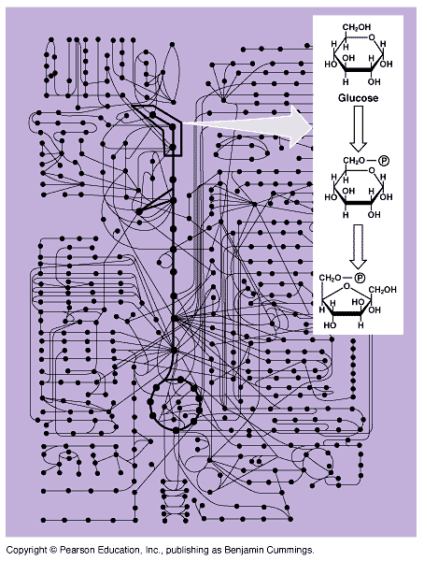
METABOLIC PATHWAYS
Metabolism
Catabolic pathways
Anabolic pathways

Slide 5
THERMODYNAMICS
1st Law of Thermodynamics
2nd Law of Thermodynamics
Energy can neither be created nor destroyed.
Entropy tends to increase in the universe.

Slide 6
ENERGY TO DO WORK
Exothermic Reaction
cellular respiration
“breaking down” (catabolic)
Endothermic Reaction
photosynthesis
“building up” (anabolic)

Slide 7
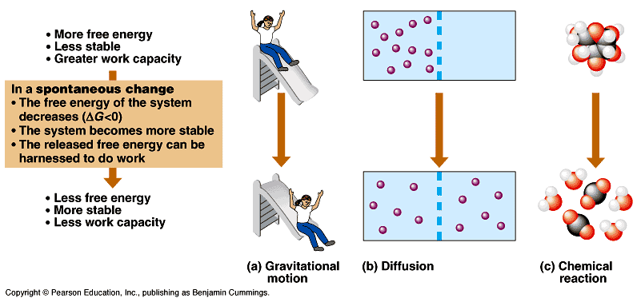

Slide 8
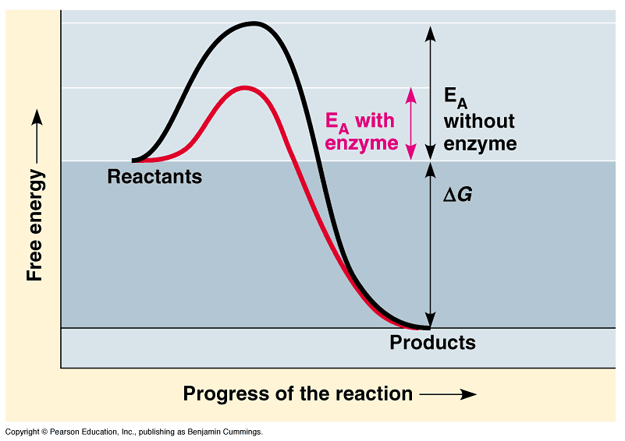
ENZYMES
Catalytic proteins
Usually tertiary in structure
Reduce activation energy (E_{A})
Reactions proceed without enzymes
Retain their structure
Substrate specific

Slide 9
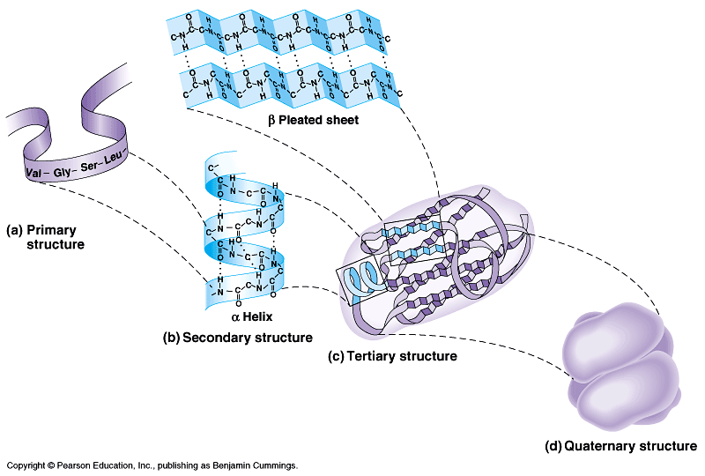

Slide 10
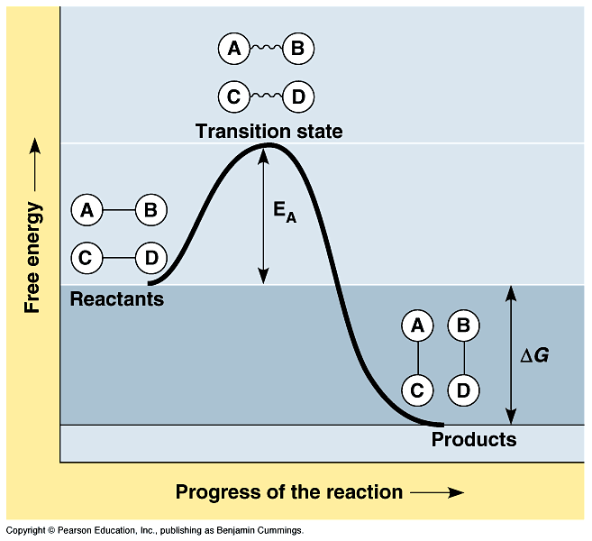

Slide 11
Substrate-Specific
Substrate(s) → Product(s)
Enzyme
Substrate(s) → Product(s)
Sucrase
Sucrose + H₂O → Glucose + Fructose
Induced Fit model
Hand Shake/Lock and Key models

Slide 12
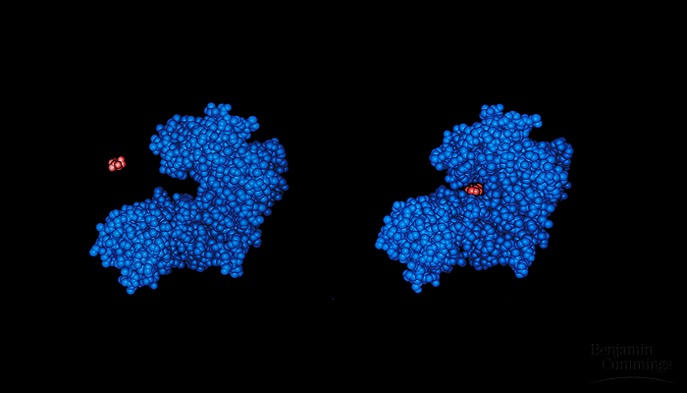

Slide 14
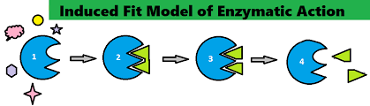

Slide 15
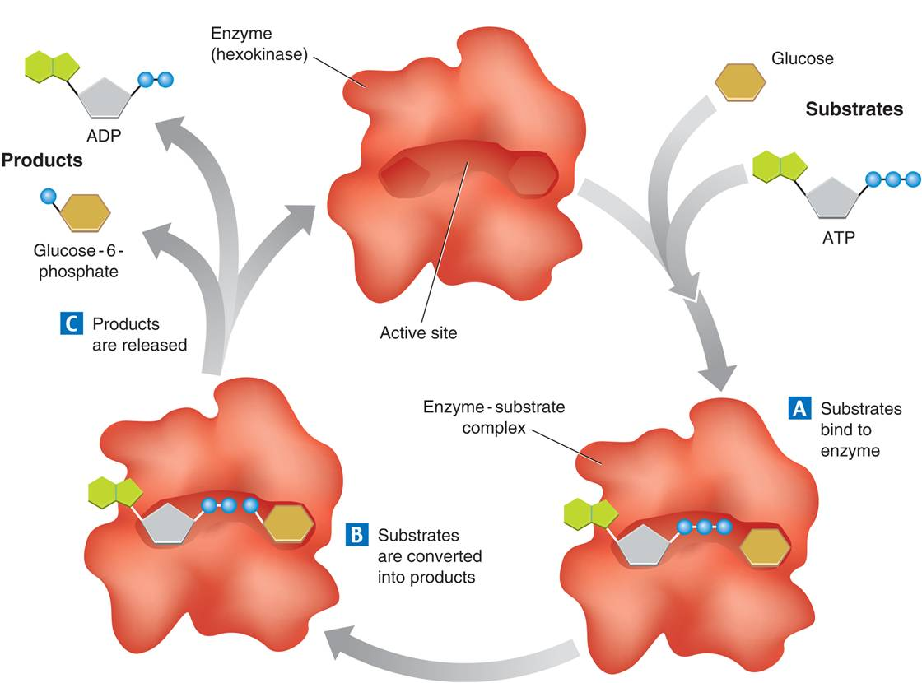

Slide 16
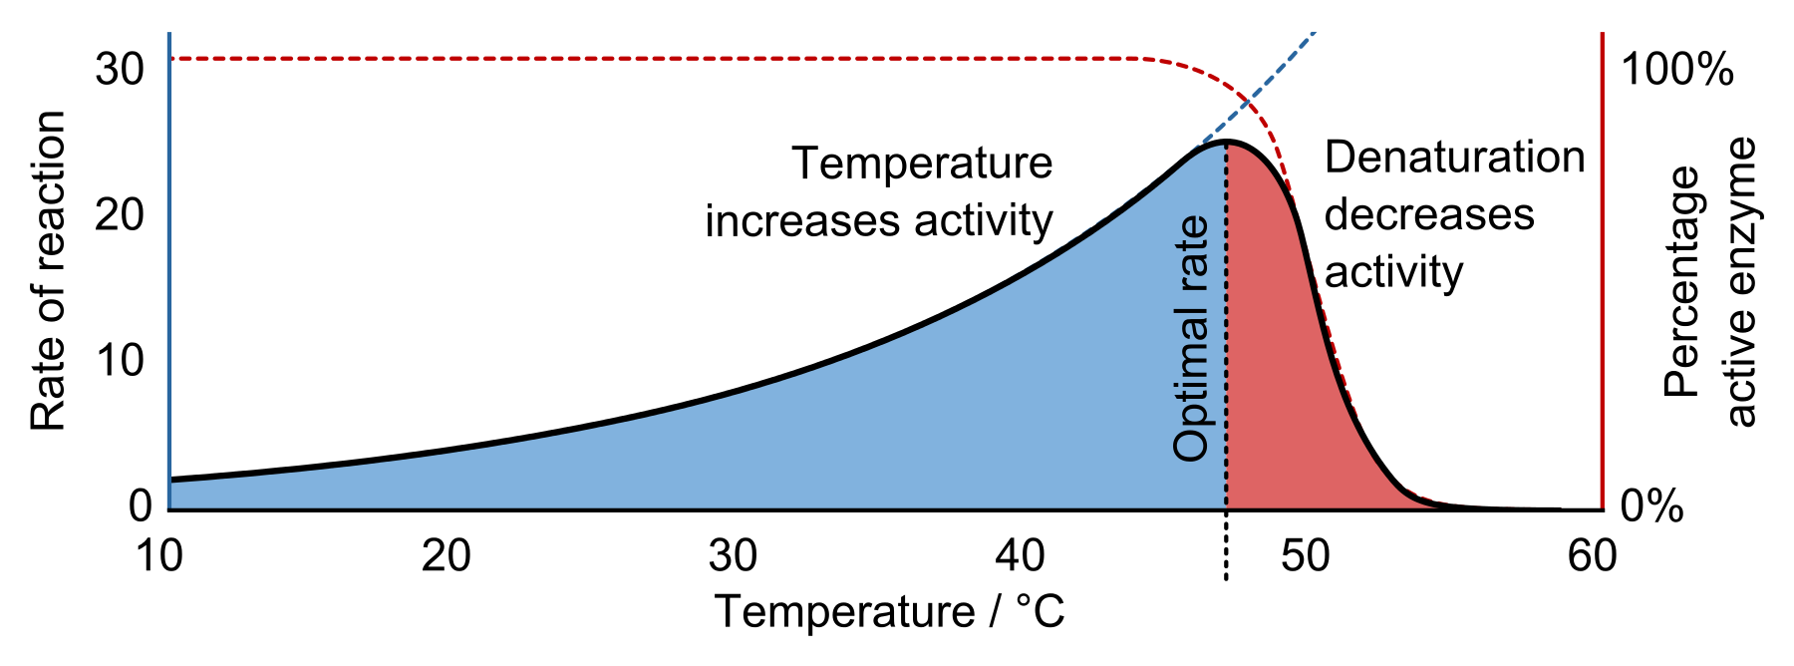
Enzymes and Optimal Conditions
This Photo by Unknown Author is licensed under CC BY

Slide 17
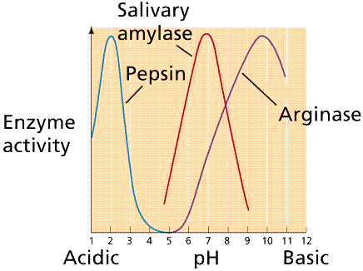

Slide 18
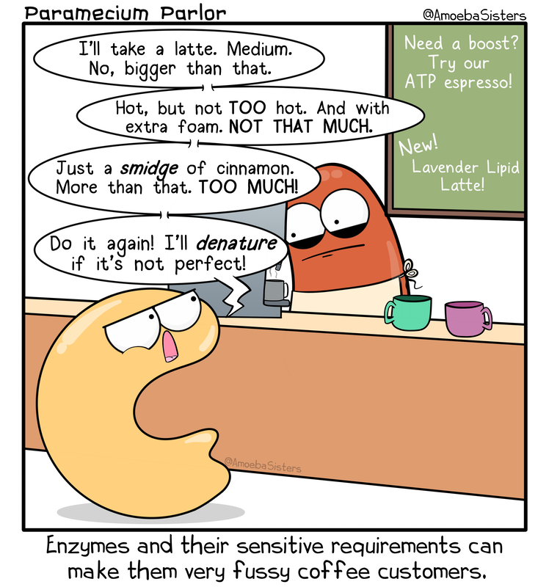

Slide 19
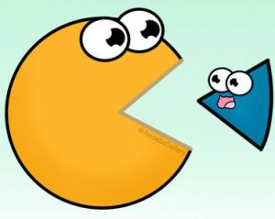
Review: Amoeba Sisters Enzymes & Mr. W.
This Photo by Unknown Author is licensed under CC BY-SA

Slide 20
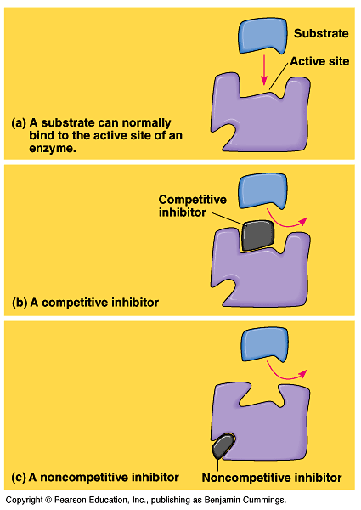
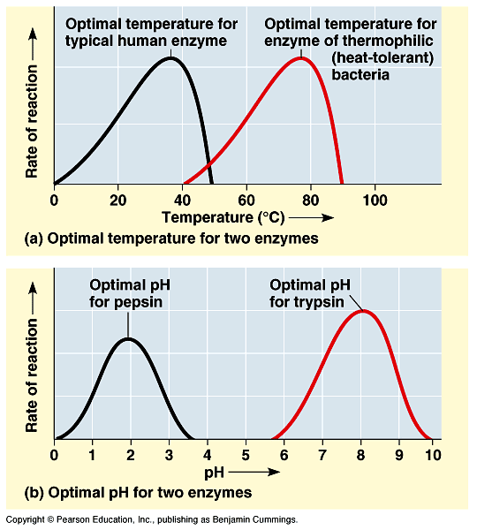
Enzyme Activity
Effects of temp & pH and other environmental variables
Enzymes inhibitors
competitive inhibitors
noncompetitive inhibitors

Slide 22
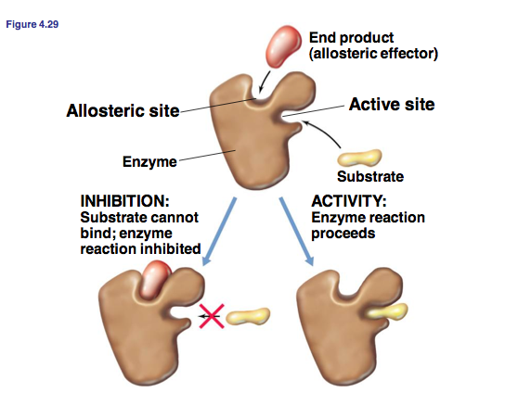

Slide 23
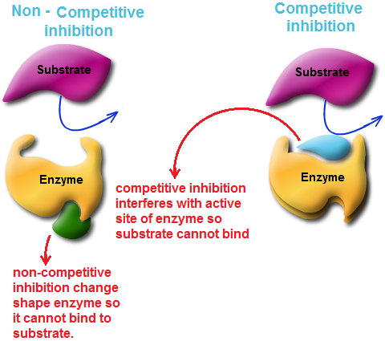

Slide 24
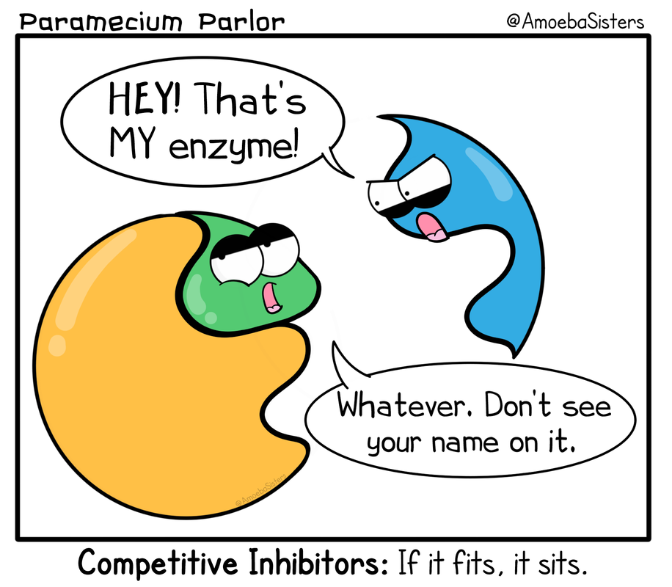

Slide 25
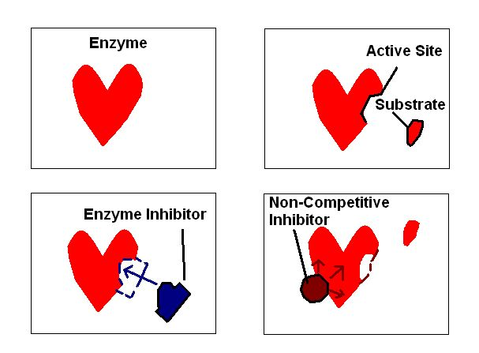

Slide 26
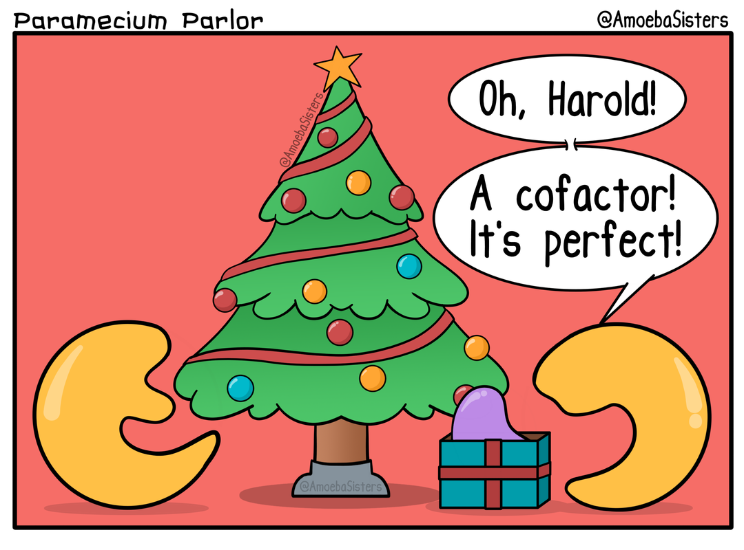

Slide 27
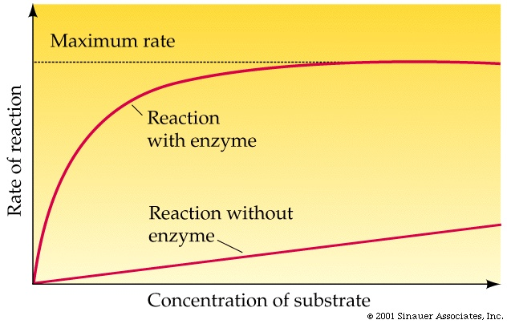

Slide 28
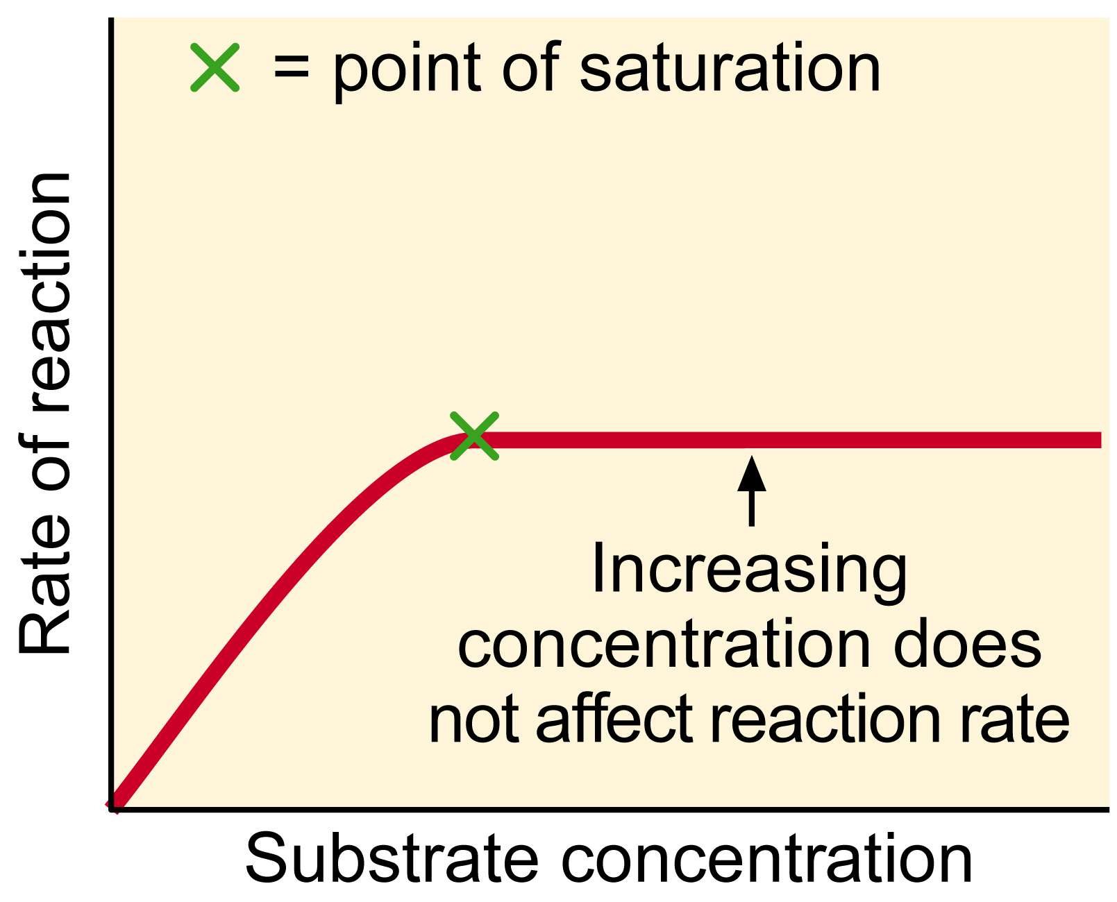

Slide 29
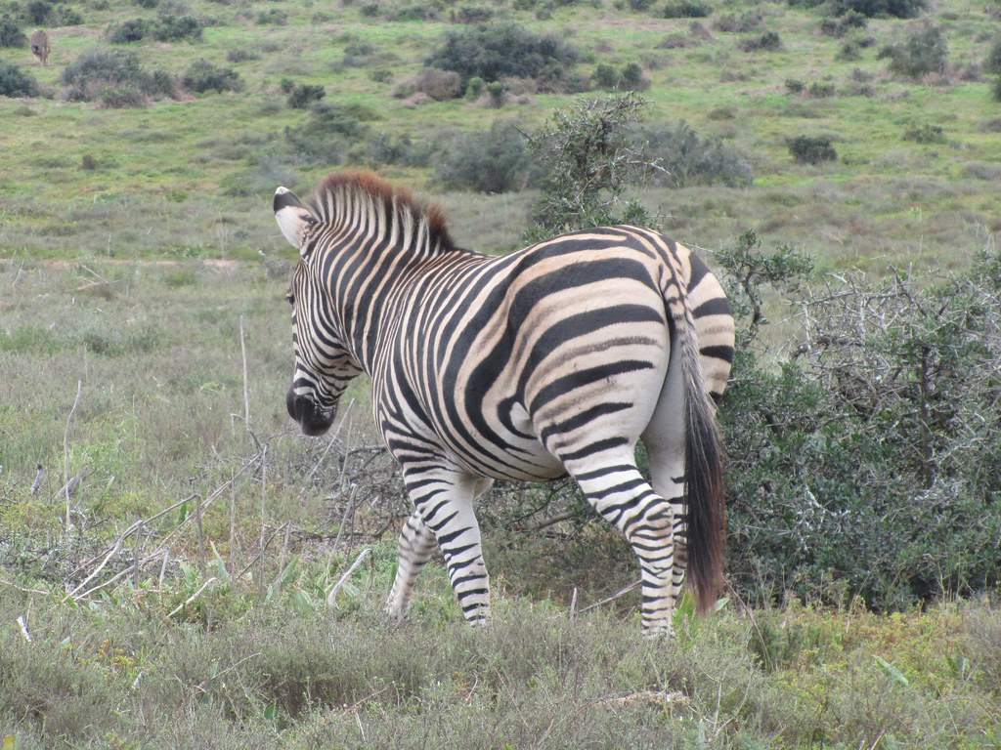
The End 2020-2022
This Photo by Unknown Author is licensed under CC BY-SA-NC

Slide 30
LAB (dry): Factors Affecting Enzyme Activity
W-H, Topics, “Enzymes and Metabolism”
Pdf, Enzyme Lab (dry)
Do ONLY the pre-lab, pages 1 & 2!!!!
Based on the reaction
2H₂O₂ → O₂(g) + 2H₂O
catalase

Slide 33
What are the effects of environmental variables on catalase activity?
What is the equation for the reaction?
As the reaction proceeds, is ΔG positive or negative? Please explain.
Homework: What environmental variables can affect the rate of the reaction?

Slide 34
What are the optimal conditions for catalase?
Temperature:
Salinity:
Enzyme/Substrate Concentration:
pH:

Slide 35
PROCEDURAL NOTES
Drops of catalase: 0, 5, 10, 20
Make sure O₂ sensor is calibrated. Does it detect approximately 20% oxygen in the air around us?
Timing is critical!
1. Add water and drops of catalase to bottle
2. Get read to grab the reaction!
3. Then add H₂O₂ (substrate)

Slide 36
INTRODUCTION TO METABOLISM AP EXAM REVIEW
Chapter 8
Metabolism, Energy,
Life, and Enzymes

Slide 37

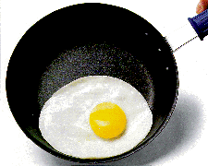
PROTEINS
Amino acids (20)
Structure
Primary (polypeptide chain)
Secondary
Tertiary
Quaternary
Enzymes
Denaturing

Slide 38
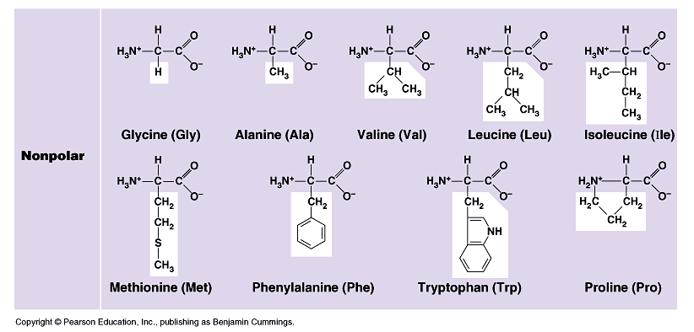

Slide 39
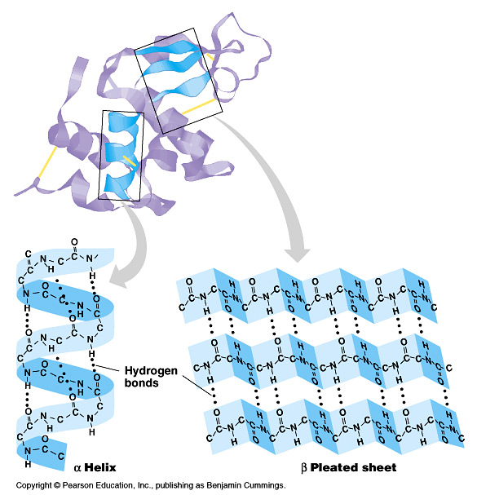

Slide 40
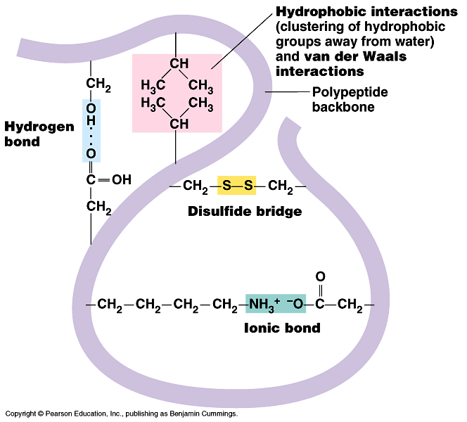

Slide 42
THERMODYNAMICS
1st Law of Thermodynamics
2nd Law of Thermodynamics
Energy can neither be created nor destroyed.
Entropy tends to increase in the universe.

Slide 43
ENZYMES
Catalytic proteins
Reduce activation energy (E_{A})
Reactions proceed without enzymes
Retain their structure
Substrate specific

Slide 44
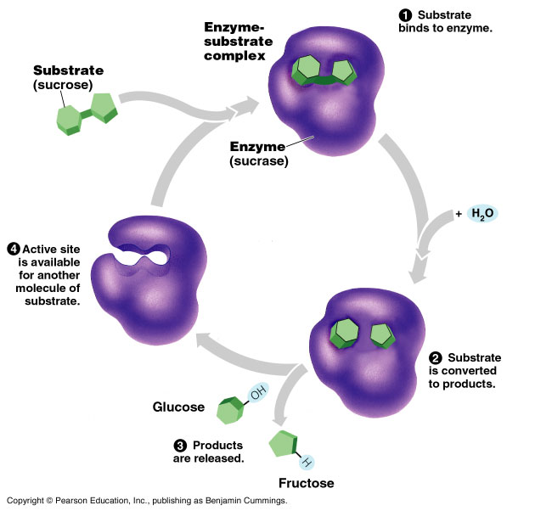

Slide 45
Enzyme Activity
Effects of temp & pH
Cofactors
coenzymes
Enzymes inhibitors
competitive inhibitors
noncompetitive inhibitors

Slide 49
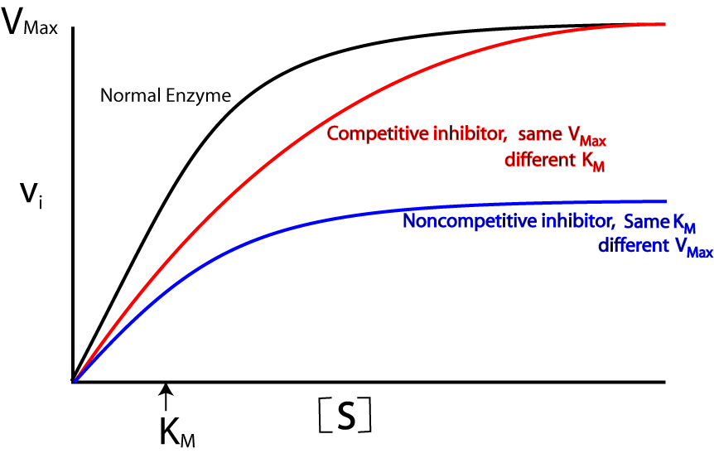

Slide 50
AP Lab 1: Investigating Enzyme Activity
2H₂O₂ → O₂(g) + 2H₂O
catalase

Slide 51
What are the effects of environmental variables on catalase activity?
What is the equation for the reaction?
As the reaction proceeds, is ΔG positive or negative? Please explain.
Homework: What environmental variables can affect the rate of the reaction?

Slide 52
What are the optimal conditions for catalase?
Temperature:
Salinity:
Enzyme/Substrate Concentration:
pH:

Slide 53
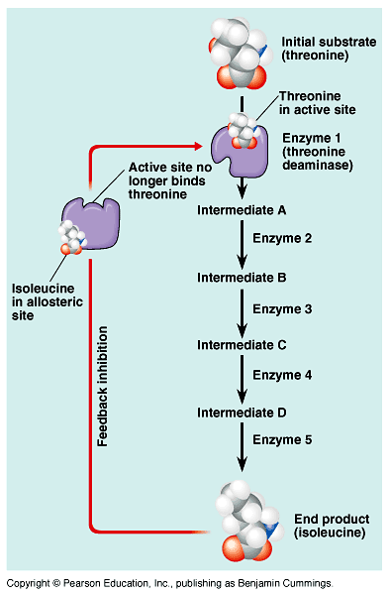
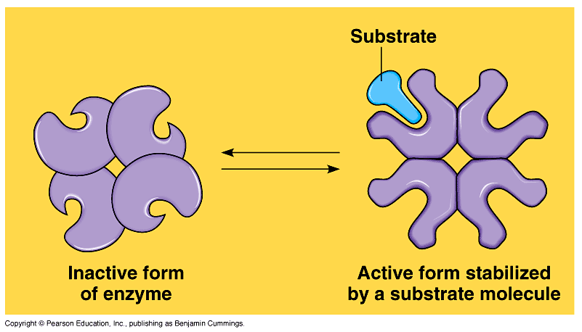
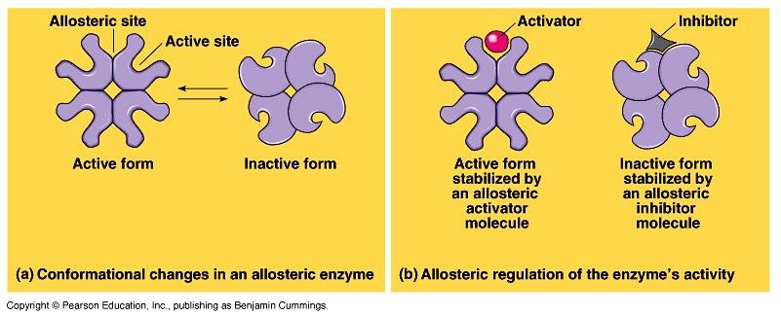
Enzyme Control
Allosteric regulation
Feedback inhibition
Cooperativity

